Slide 1

Market & Retail Analysis
MRA Milestone - 2
ANAND R J

Slide 2
AGENDA
The project involves conducting a thorough analysis of Point of Sale (POS) Data for providing recommendations through which a grocery store can increase its revenue by popular combo offers & discounts for customers.
SUMMARY OF THE DATA
We have received the 2 years and 2 months data of a Grocery store. Consisting 20641 entries with 3 variable details regarding the demography of the transaction and item information.

Slide 3

PROBLEM STATEMENT
DATA SUMMARY
EXPLORATORY DATA ANALYSIS
MARKET BASKET ANALYSIS
ASSOCIATION RULE
KNIME WORKFLOW
THRESHOLD VALUES OF LIFT VALUES, SUPPORT AND CONFIDENCE
LIFT VALUES, SUPPORT AND CONFIDENCE
ASSOCIATION RULE IN TABULAR FORM
ANALYSIS REPORT
SOLUTION
CONTENTS

Slide 4
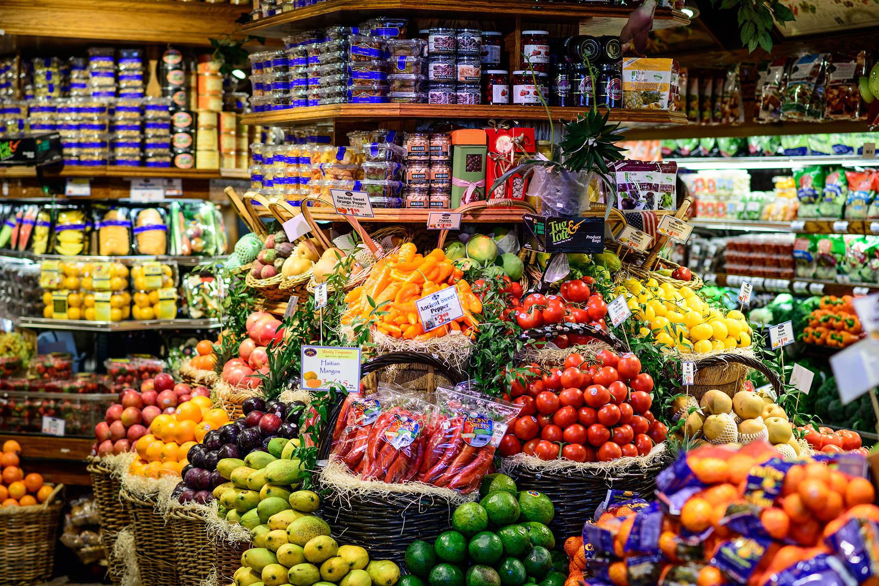
PROBLEM STATEMENT
GROCERY STORE DATA
A Grocery Store shared the transactional data with you. Your job is to identify the most popular combos that can be suggested to the Grocery Store chain after a thorough analysis of the most commonly occurring sets of items in the customer orders. The Store doesn’t have any combo offers. Can you suggest the best combos & offers?
Grocery Store Data: dataset_group.csv

Slide 5

DATA SUMMARY
The data is about an Grocery store. They have provided the data collected of transactions for 2 years and 2 months.
The data has 20641 entries (0 To 20640) of rows and 3 columns.
The data has 2 object data type and 1 integer data type.

Slide 6

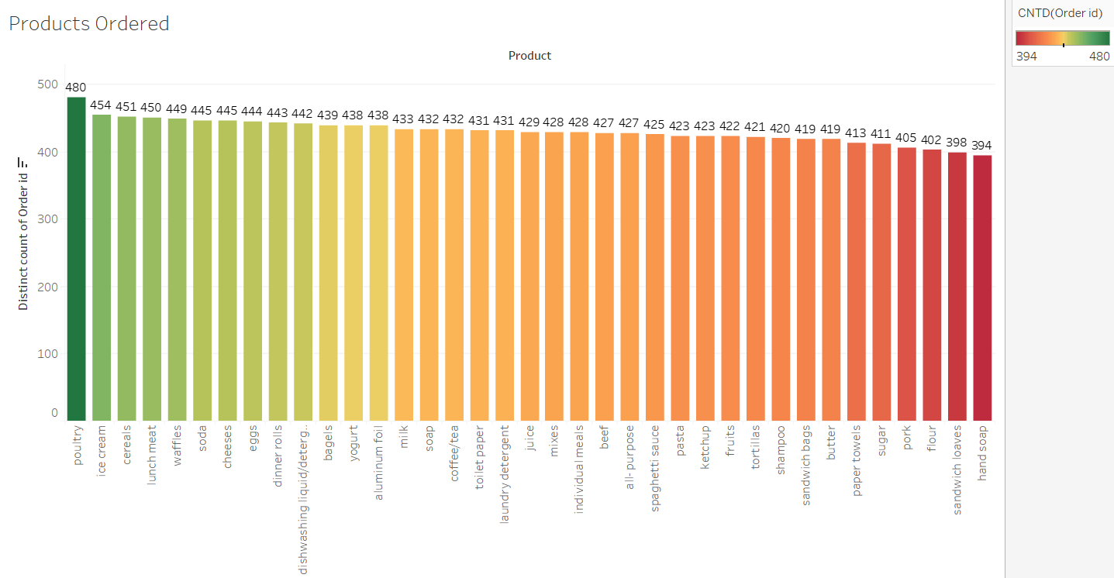
EXPLORATORY DATA ANALYSIS
PRODUCT ORDERED
It is evident that Poultry has been ordered the highest with 480 followed by ice cream with 454 orders.
The lowest is hand soap 394 orders and sandwich loaves with 398 orders.
The milk, soap, coffee/tea, soda, cheese are more or less holds the same amount of orders.

Slide 7
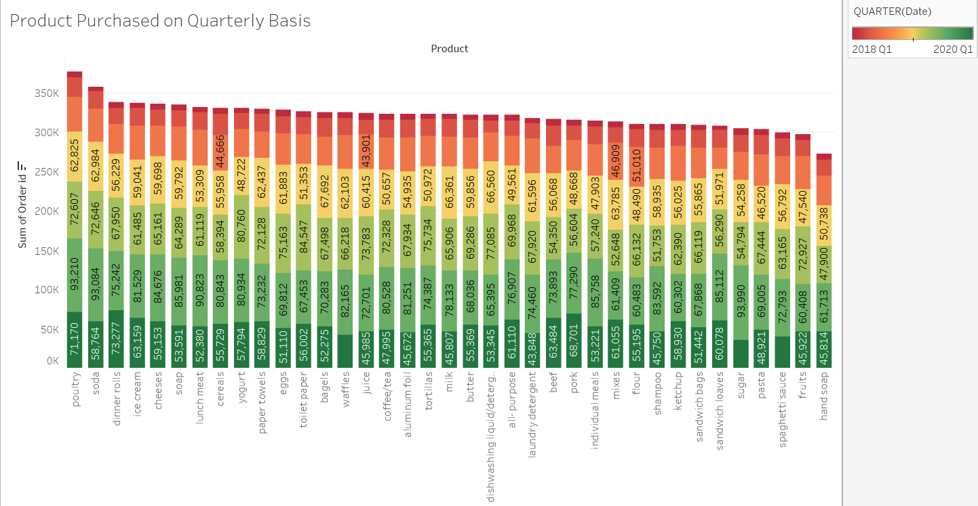
EXPLORATORY DATA ANALYSIS
PRODUCT PURCHASED QUARTERLY FOR 2018, 2019 AND 2020
The transaction report doesn’t have data of 4th Quarter for each year .Other wise the most transact year is 2019 Q3 followed by 2019 Q2.

Slide 8
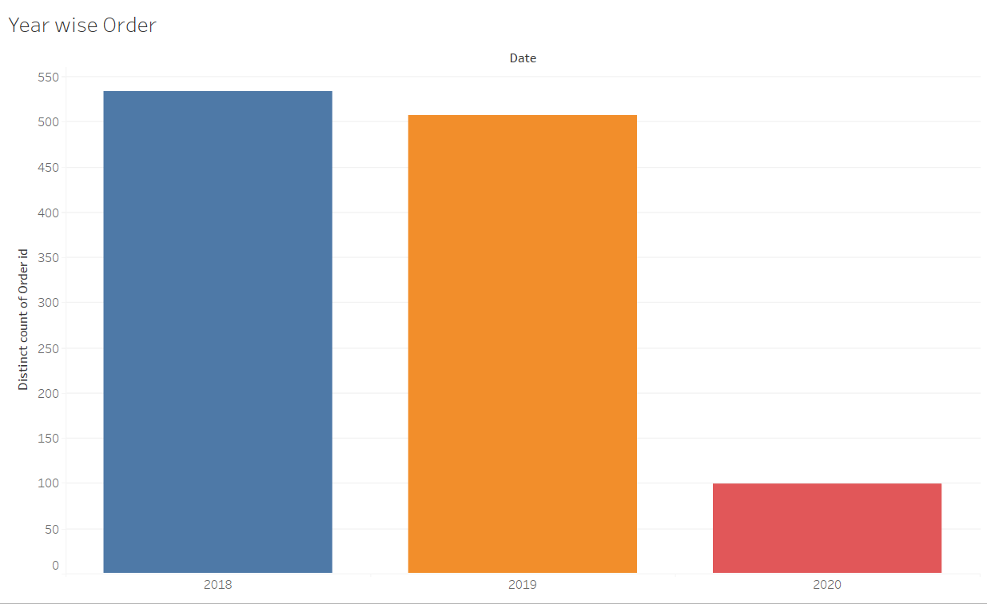
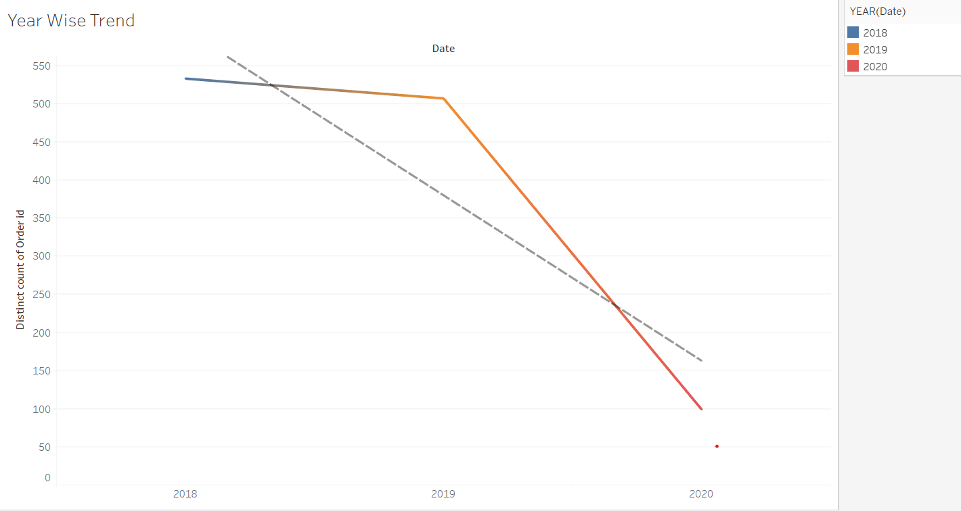
EXPLORATORY DATA ANALYSIS
Yearly Orders and its Trends
The total number of orders are highest in the year 2018.
Followed by 507 orders in 2019.
2020 has registered only 99 orders. As only two months data is given in the data set , this might be a reason for low order count.
Trends shows that the number of orders placed has been decreasing yearly.
Also it shows a downward trend and no forecast has been generated with this data.
The
R-Squared value is- 0.79476
P-Value – 0.299317

Slide 9
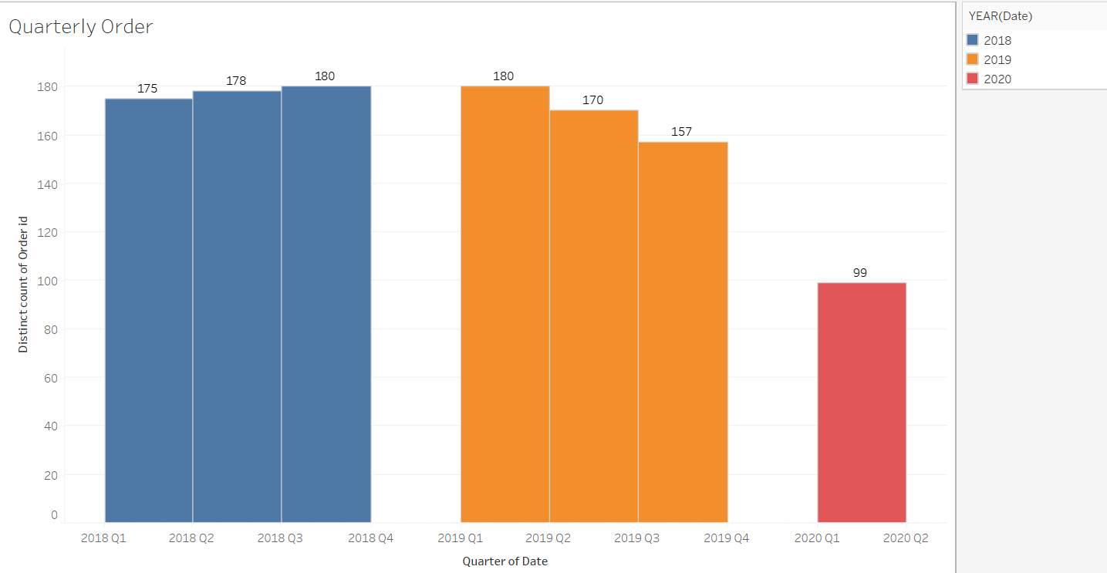
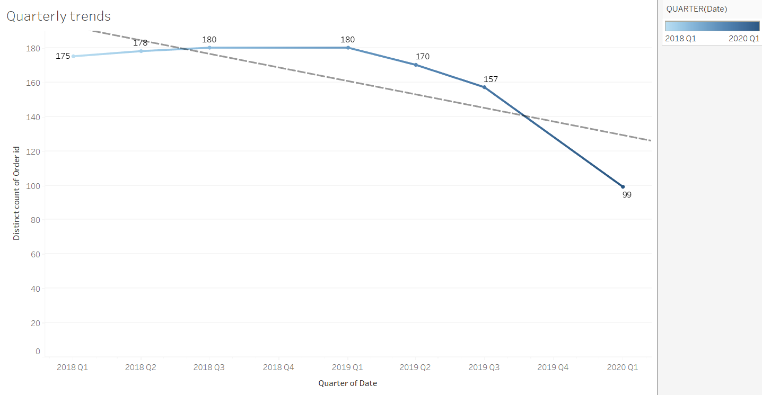
EXPLORATORY DATA ANALYSIS
Quarterly Orders and its Trends
In 2018, Q3 had the highest number of orders with 180.
In 2019, Q1 had the highest with 180.
This started decreasing as quarters passed by. The lowest was recorded in Q1 of 2020.
Also, it is evident that Q4 of every year doesn’t have any sales.
No proper trend can be analysed in terms of Quarter sales.

Slide 10
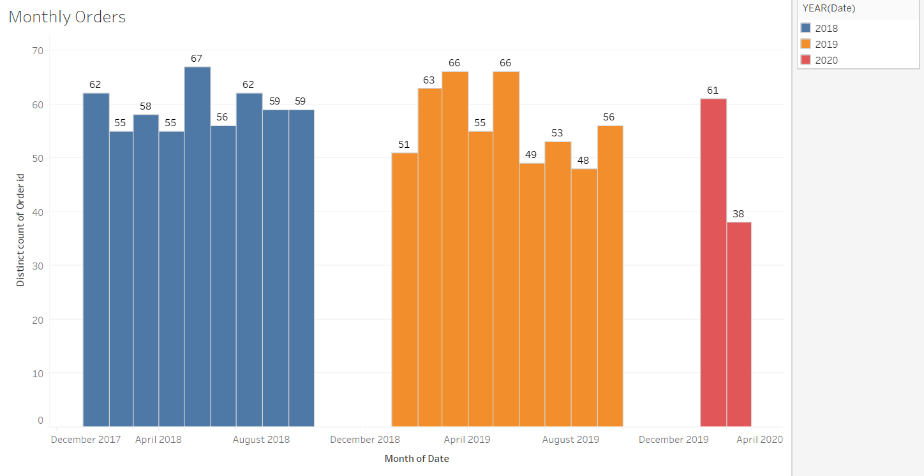
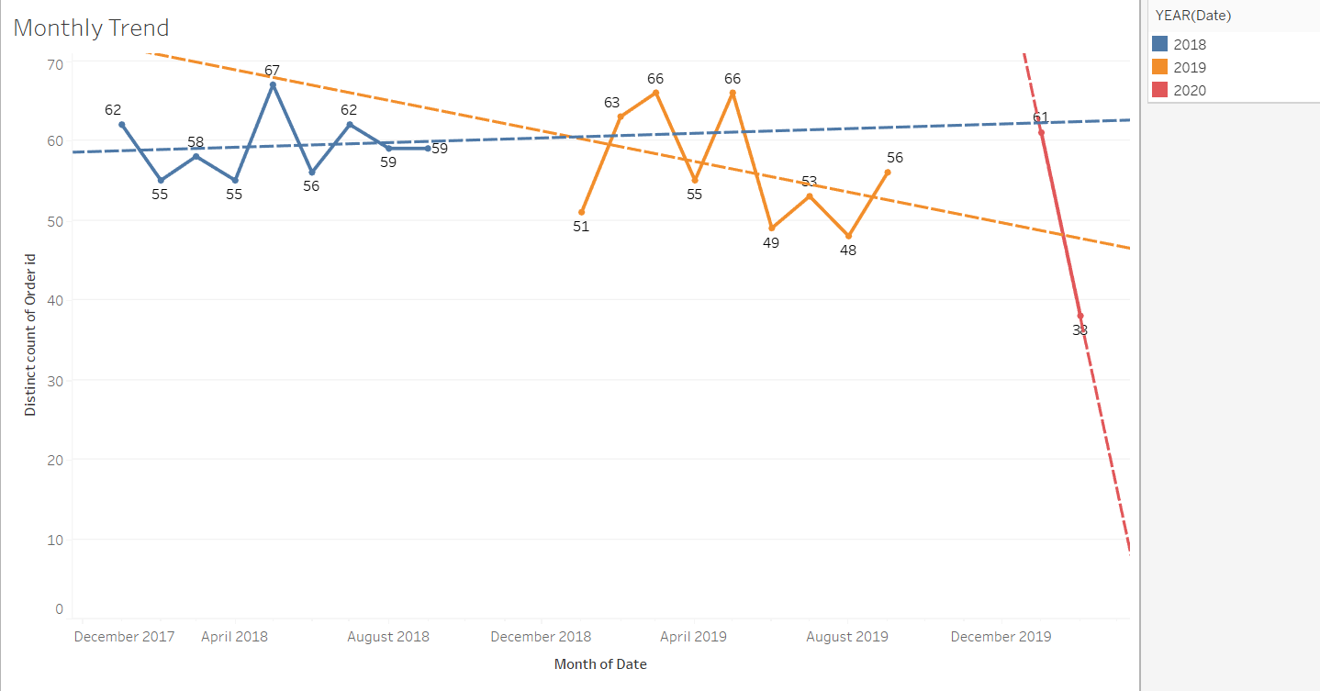
EXPLORATORY DATA ANALYSIS
Monthly Orders and its Trends
There is no trend and seasonality available in the data provided.
As per the forecast the sales would tend to increase in the mid quarters of the years.
January, February and May month has the highest numbers of sales.
There was a drastic decrease in the year 2020 of February month.
We can not determine the reason behind it as the records shows only the data for two months.

Slide 11
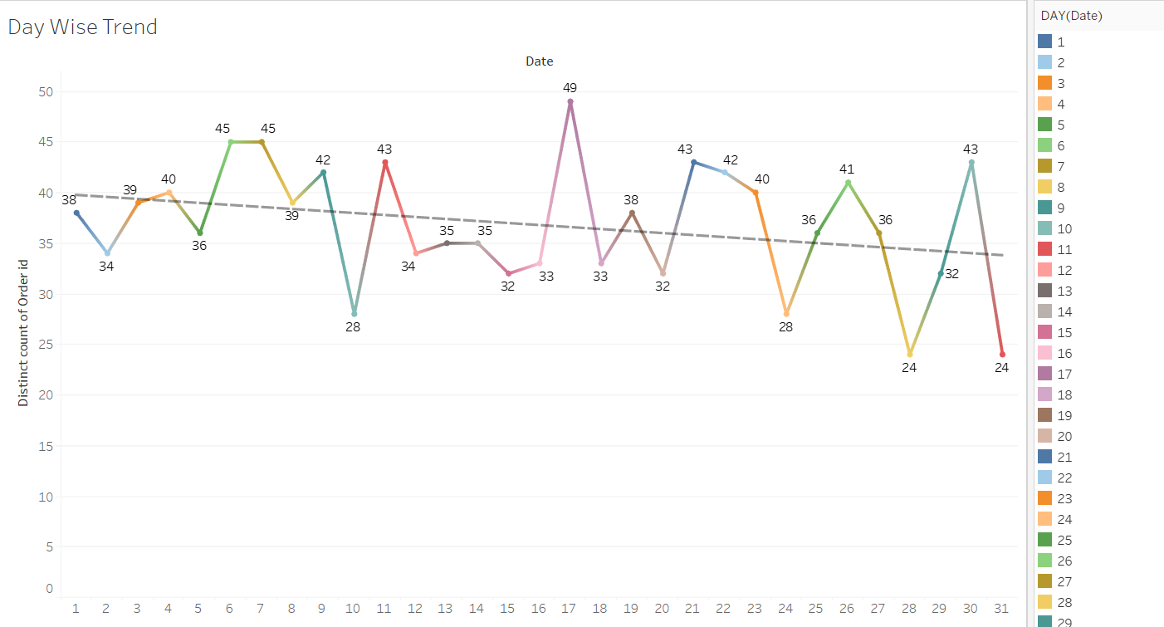
EXPLORATORY DATA ANALYSIS
Day Wise Orders and its Trends
The highest distinct count of ordered date is 17.
No proper trend can be analyzed using daily wise orders.

Slide 12

MARKET BASKET ANALYSIS
Using appropriate Algorithm to do Market Basket Analysis of Customers purchasing behaviors. It can predict what the customer is going to buy next by looking at the products he is buying.
Market Basket Analysis is a modelling technique based upon the theory that if you buy a certain group of items, you are more (or less) likely to buy another group of items. For example, you buy a loaf of bread and don't buy a milk, you are more likely to buy crisps chips or salad at the same time than somebody who didn't buy milk.

Slide 13
MARKET BASKET ANALYSIS (ASSOCIATION RULE )
Association Rule Mining is used when you want to find an association between different objects in a set, find frequent patterns in a transaction database, relational databases or any other information repository.
Support, confidence level, and lift are the three measures used to compute it.
High-support rules are more likely to apply to a significant number of future transactions.
You can expect higher return rates if you have more confidence.
The strength of the relationship between the products on the antecedents and consequents columns of the association is summarised by lift.
Larger the lift, greater the link between the two products.
When you apply Association Rule Mining on a given set of transactions T your goal will be to find all rules with:
Support greater than or equal to min support
2. Confidence greater than or equal to min confidence
There are 20,642 records in the grocery dataset, totalling 1139 orders.
Customers have purchased numerous goods in a single order, with an average of 18 products per buy.
As a result, it is critical to investigate the association between two items.
Once the relationship has been assessed, actions can be taken based on the confidence and lift indicators to boost sales by offering combos and giftpacks.

Slide 14
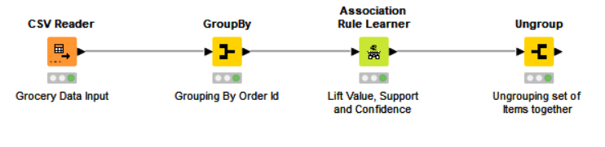
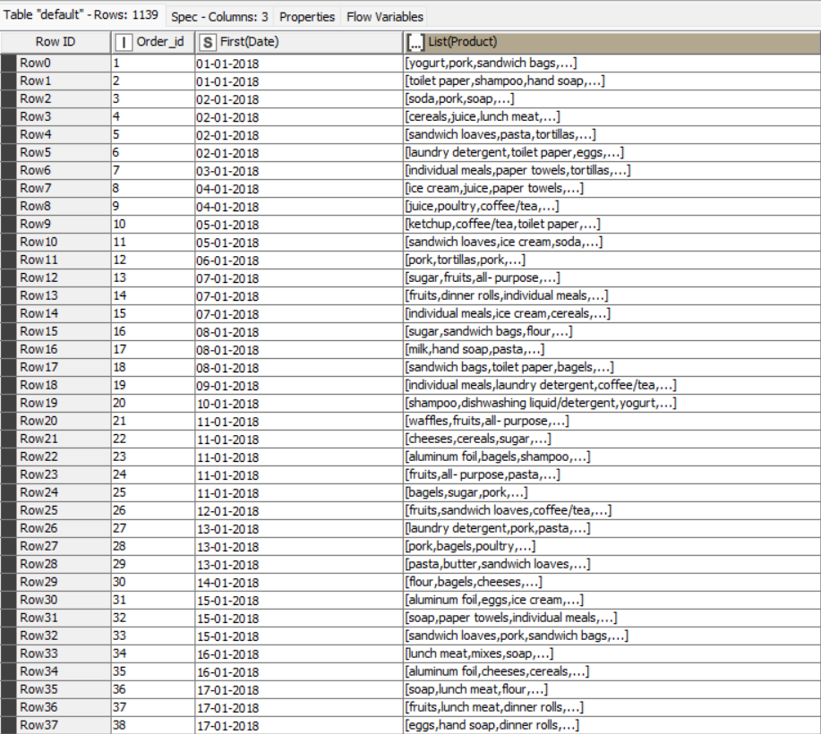
KNIME Workflow
KNIME has been used in order to understand different association rules.
The data has been grouped according to the order ID.

Slide 15
Threshold Values of lift values, Support and Confidence
Association Rule Mining is used when you want to find an association between different objects in a set, find frequent patterns in a transaction database, relational databases or any other information
Support and Confidence measure how interesting the rule is. It is set by the minimum support and minimum confidence thresholds.
These thresholds set by client help to compare the rule strength according to your own or client's will.
The closer to threshold the more the rule is of use to the client.
Frequent Item sets:
Item-sets whose support is greater or equal than minimum support threshold (min_sup).
Strong rules:
If a rule A=>B[Support, Confidence] satisfies min_sup and min_confidence then it is a strong rule.
Lift:
Lift gives the correlation between A and B in the rule A=>B.
Correlation shows how one item-set A effects the item-set B.
Lift(A=>B)=Support(A)Support(B)
A rule may appear to have a strong association in a data collection because it appears frequently, but it may emerge much less frequently when applied.

Slide 16
Lift values, Support and Confidence
The Below Information can vary based upon the dataset sizes.
There is no particular threshold value of support. If the dataset is large then it is advisable to set the value at 10% and increase it accordingly till required number of associations are generated.
The threshold value of support in this case is 10%. Association rules are not developing if the value goes beyond 10%
Also, the confidence is kept at 40% which is optimal level.
The associations with highest lift values are considered to be accepted more.
In the following case, the association rule is formed highest lift value that is 12.34% at a confidence level of 46% and support of 18%.
This rule implies that the customers who bought dishwashing also purchased mixes.
Also the customers who bought soda have high chances of buying eggs.

Slide 17
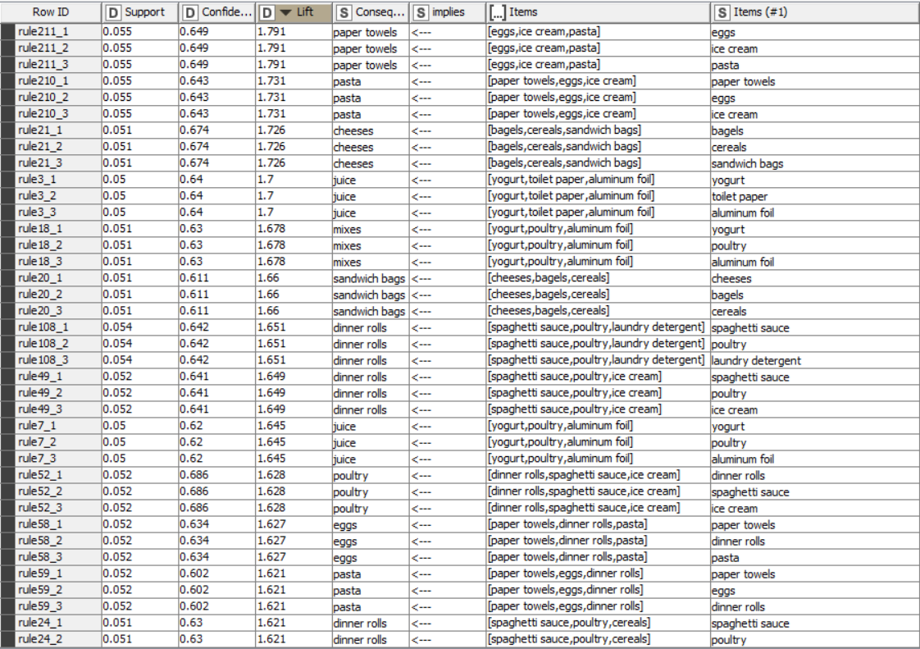
Association Rule in Tabulation form
The output has been analysed in the form of descending order of Lift, as higher the list higher will be the association.

Slide 18
Analysis Report
From the analysis, one can conclude that the number of orders has been falling drastically over the years.
The highest number of orders was in 2018 and then followed by 2019.
The Q4 data has not been provided or can conclude that there are no orders placed in Q4.
The store can provide discounts in the middle of the month in order to attract more customers.
Poultry and ice-creams are most frequently ordered items. It is advisable to increase the variety of items in this category so that customers will have a lot to choose.
The months of mid quarters have been showing a consistent performance over the years.
Also one can conclude that the numbers of orders are high in starting and end days of the months.
This can be because most of the customers get their pay either at the starting or at the end of every month.
either at the starting or at the end of every month.
Hand soaps and loaves are least purchased items. So the store can invest a bit less on these items.
In order to increase the sales, Q4 is crucial part for many businesses as it is festive season customers tend to order a lot.
It is advisable to provide the service in Q4 as well.
The decrease in the orders over the years can be of many reasons like poor customer service or no proper offers provided. It is recommended to look into the service and provide customers the highest satisfaction in terms of service as well as products.

Slide 19
Solution:
Also most of the customers are inclined to buy ketchups along with sandwich bags, the store can provide an offer saying get 1 ketch up free with 2 sandwich bags
An offer like buy 1 kg of beef and get 1 kg of assorted fruits free can be provided to the customers.
Since hand soaps are least preferred by customers they can be combined with any of the highest selling product.
Hand soaps can be combined with detergents to increase the purchase of hand soaps as well.
Sandwich loaves if also one of the least selling products. It is evident that people who buy loaves also buy individual meals. So the store can provide combo offer like buy three meals and get 5 sandwich loaves free.
In order the increase the sales, the grocery store can provide combo offers to its customers.
Top 5 combos according to Market Basket Analysis are:
paper Towels & eggs
2. Pasta & Paper Towels
3. Cheese & beagles
4. Juice & yogurt
5. mixes & yogurt

Slide 20
THANK YOU
Milestone 2 MRA Project – Market Basket Analysis
Tableau Link
https://public.tableau.com/app/profile/anand.ramaswamy/viz/GroceryStoreDataVisualization/DayWiseTrend

